Slide 1
MathSec: Towards a Mathematical CAPTCHA for Establishing Secured Access
Subject: Project-I
Paper Code: CSE 791
Under the Supervision of
Mr. Sumit Gupta
Assistant Professor
Department of Computer Science and Engineering
University Institute of Technology
The University of Burdwan
Arnab Das (Roll no.-2014-1011, Regn. No.- A2360 of 2014-15)
Saikat Sar (Roll no.-2014-1070, Regn. No.- A2409 of 2014-15)
Suraj Mondal (Roll no.-2014-1071, Regn. No.- A2410 of 2014-15)
Durlov Ghosh (Roll no.-2014-1012, Regn. No.- A2361 of 2014-15)

Slide 2
Agenda
Introduction
Previous Work
Proposed Work
Result
Discussion and Analysis
Future Work
Conclusion
References

Slide 3
Introduction
CAPTCHA -> Completely Automated Public Turing test to tell Computers and Humans Apart.
Invented by Luis von Ahn, Manuel Blum, J. Hopper and John Langford.
Two main requirements : Robustness and Usability
Robustness :- Strength to defend against different kinds of attacks.
Usability :- The ease with which humans pass its challenges.

Slide 4
MAPTCHA -> Mathematical CAPTCHA
It is easy and effective.
In our project, we have proposed our own MAPTCHA algorithm i.e. “MathSec” which overcome some disadvantages of previously proposed MAPTCHA algorithms.

Slide 5
Types of CAPTCHA
Different types of CAPTCHA are there:
Text CAPTCHA:- The most popular type of CAPTCHA is text-based CAPTCHA .
Audio CAPTCHA:- Human beings and bots are distinguished with their ability of listening by audio CAPTCHA .
Fig 1: Text CAPTCHA
Fig 2: Audio CAPTCHA

Slide 6
Image CAPTCHA:- Images which are well matched with a theme are selected in this kind of CAPTCHA. That is, contents in the images must be recognized.
Fig 3 : Image CAPTCHA

Slide 7
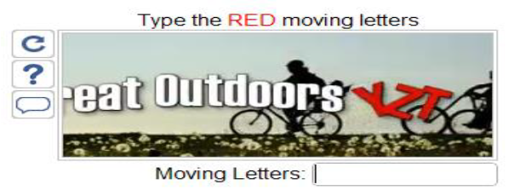
Video CAPTCHA:- Video CAPTCHA is one of subspecies of image CAPTCHA.
Other kinds of CAPTCHAs may include 3D CAPTCHA, Commercial CAPTCHA etc.
Fig 4: Video CAPTCHA

Slide 8
MAPTCHA
MAPTCHA is Mathematical CAPTCHA.
It is easy and effective.
Not too complicated for human to understand.
It seamlessly integrates into login, registration, lost password, comments and Contact Form.
Applications:- Used in Word Press.
Fig 5: MAPTCHA

Slide 9
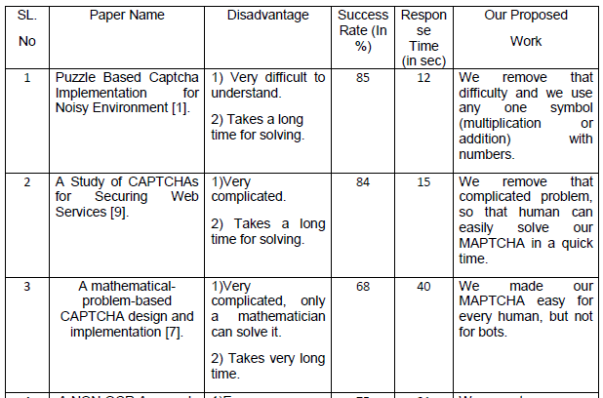
Previous Work
Comparative study of existing MAPTCHA systems:-

Slide 10

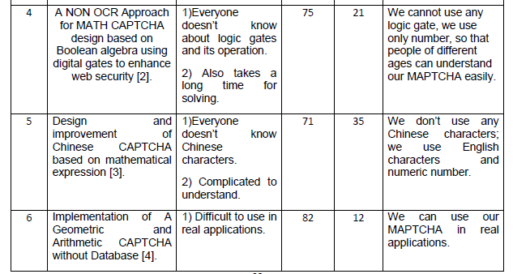

Slide 11
Proposed Work
To overcome the disadvantages of different kinds of CAPTCHA as we have already discussed we have built our own MAPTCHA.
Texts rotated at different angles clockwise / anticlockwise which are shown as images to the human in a Registration form.
A particular angle is selected and multiplied with a value generated by random value generator uniformly distributed in the range of 0 to 1.

Slide 12
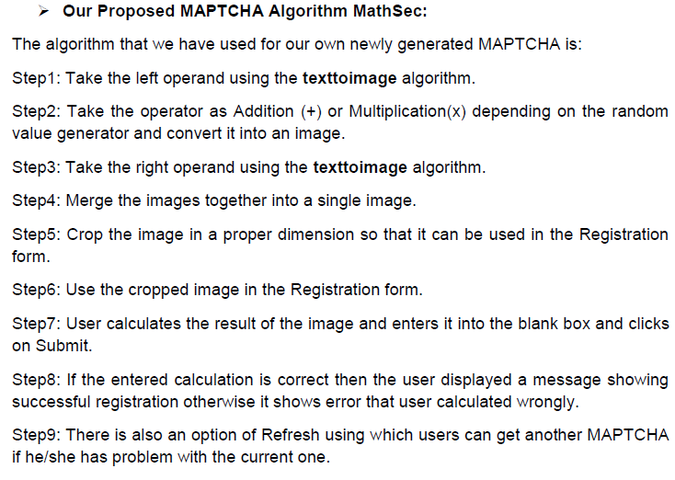

Slide 13
texttoimage algorithm:-
Step1: Take some random text which can be numerical or alphabetical. Example- 7 or Seven.
Step2: Convert the text into its corresponding image.
Step3: Rotate the image clockwise or anticlockwise depending on the random value generator at a particular angle.

Slide 14
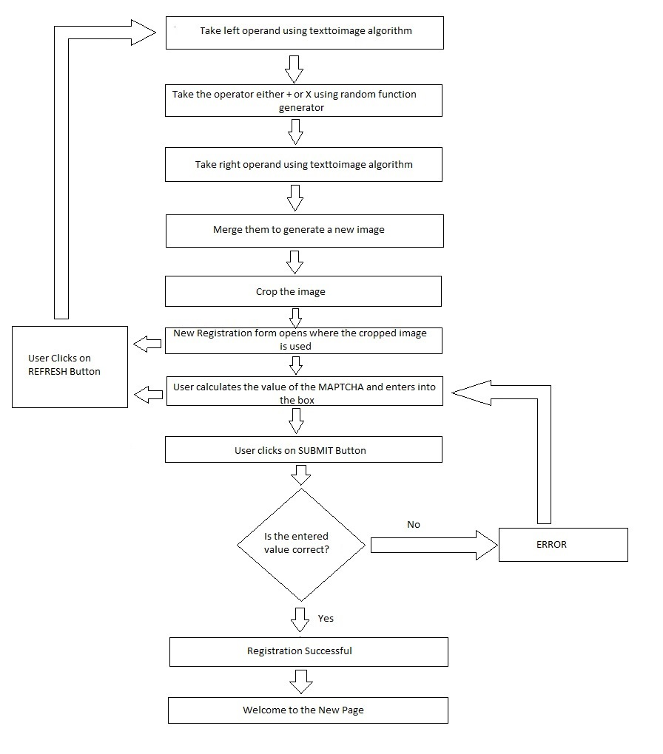
Flowchart of our proposed MAPTCHA Algorithm :-
Fig 6: Flowchart of our proposed MAPTCHA Algorithm

Slide 15



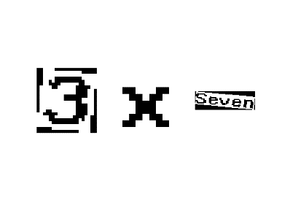

Implementation
Step1:
Step2:
Step3:
Step4:
Step5:
Fig 7: Step1
Fig 8: Step2
Fig 9: Step3
Fig 10: Step4
Fig 11: Step5

Slide 16
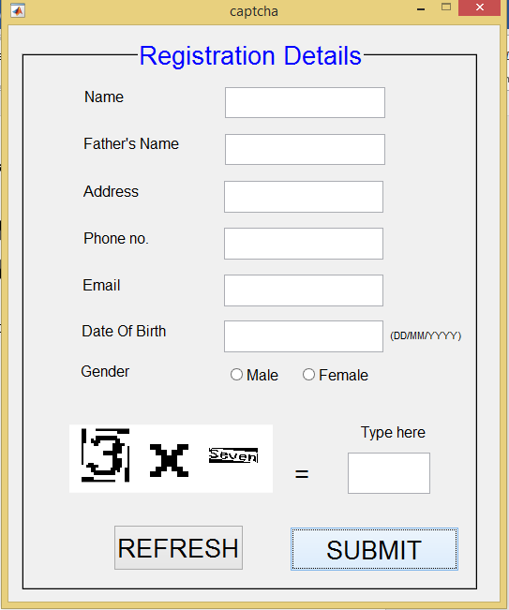
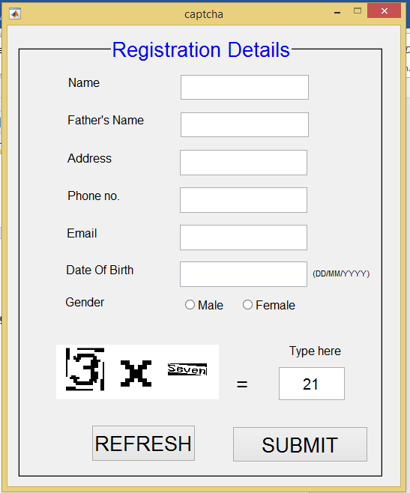
Step6:
Step7:
Fig 12: Step6
Fig 13: Step 7

Slide 17
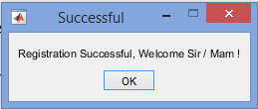
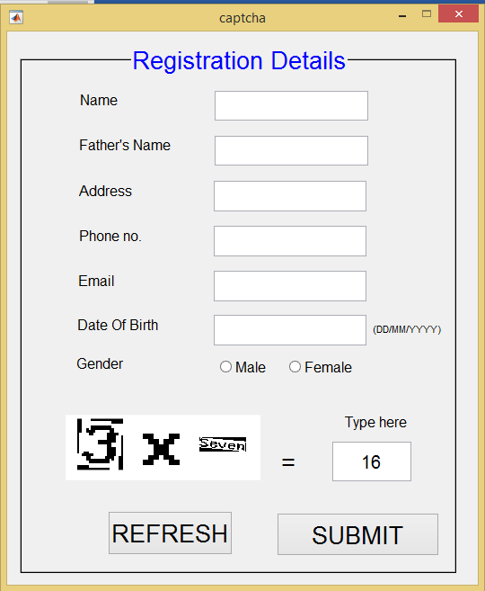
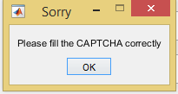
Step8:
Fig 14: Step8
Fig 15: Step8
Fig 16: Step8

Slide 18
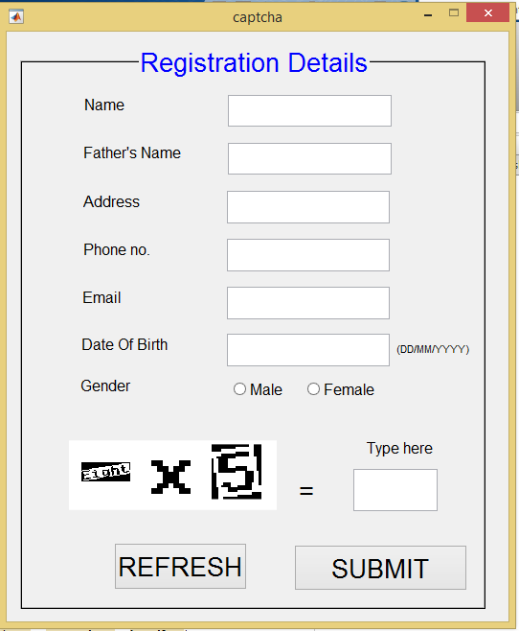
Step9:
Fig 16: Step9

Slide 19
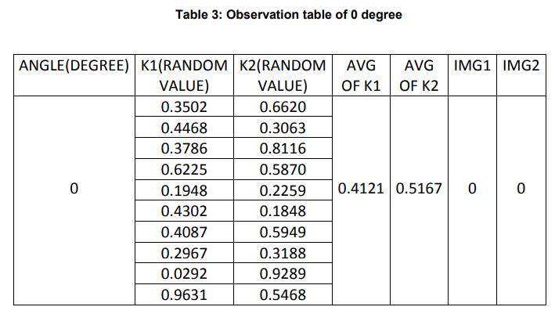
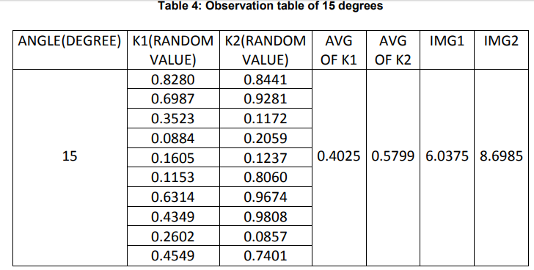
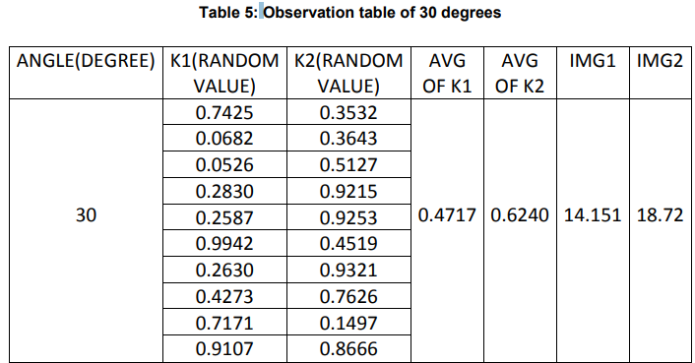
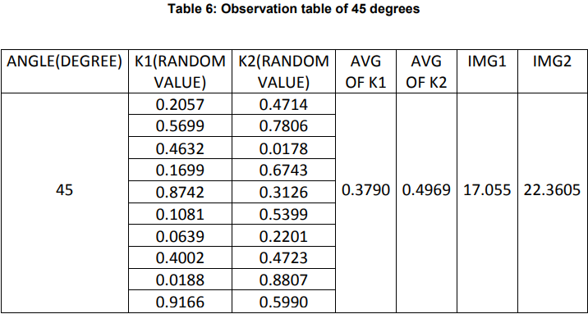
Result

Slide 20
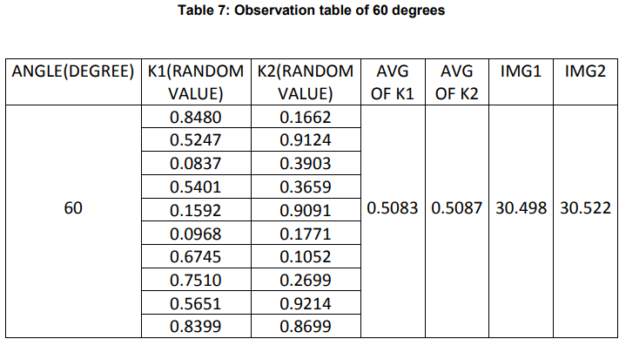
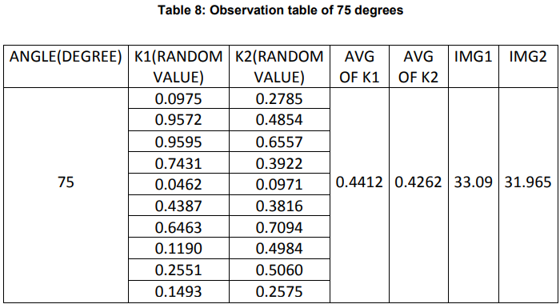
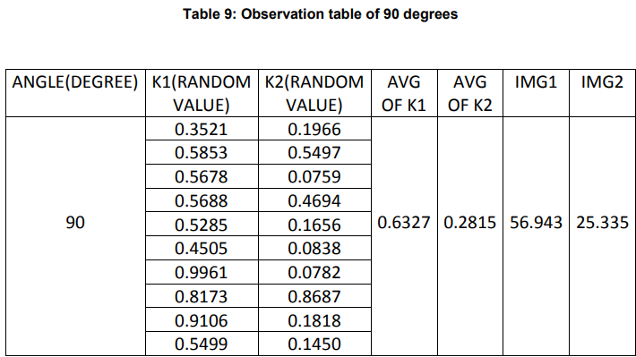

Slide 21
Discussion and Analysis
We have used MATLAB R2017a software.
For finding the random values we have used rand() function which is built-in function in MATLAB.
60 degrees gave us good results than other angles.
So, we choose 60 degrees as the optimum angle .
It is multiplied with random variables to obtain the angles in which images of the operands are to be rotated.

Slide 22
Future Work
In future we will try to make our proposed MAPTCHA algorithm to be more robust and usable.
To make it robust we will try to do different kind of attacks on our MAPTCHA and find some loopholes in it and then improve it .
To make it usable we will make it as simple as possible for human.

Slide 23
Conclusion
CAPTCHAs are an effective way to counter bots and reduce Spams.
They Help advance In AI knowledge.
In this project, we have proposed our own MAPTCHA algorithm.
Robust and Usable.

Slide 24
References
1) Panagiotis Germanakos, Marios Belk “E-book: Human–Computer Interaction Series” Jean Vanderdonckt, Université catholique de Louvain, Belgium, ISSN 1571-5035, ISBN 978-3-319-28050-9 (eBook), Springer International Publishing Switzerland 2016.
2) Jeff Yan and Ahmad Salah El Ahmad “Pixel-Count Attacks: CAPTCHA Security,” Newcastle University, England, CO
Published by the IEEE Computer and Reliability Societies, July/August 2009.
3) Jeff Yan, Ahmad Salah El Ahmad “Breaking Visual
CAPTCHAs with Naïve Pattern Recognition Algorithms”,
School of Computing Science, Newcastle University, UK.
4) Puchong Subpratatsavee, Preeyawal Kuha, Narongrit Janthong, Chanchira Chintho, “An Implementation of A Geometric and Arithmetic CAPTCHA without Database”, Department of Apply Mathematics Faculty of Science at Si Racha, Kasetsart University
Chonburi, Thailand, 2014 IEEE.
5) J.O. Okesola(School of Computing University of South Africa South Africa), Longe O. B.( Department of Computer Science & Mathematics Adeleke University, Ede, Osun State, Nigeria.), A.P. Obi, “Towards the Development of a Time-Out Multiple C-R CAPTCHA Framework Using Integrated Mathematical Modeling”, African Journal of Computing & ICT Reference Format, Vol 8. No. 2 June, 2015.
6) HIEU TRONG HO, “Enhancing WWW Security Through CAPTCHA by Leveraging Cognitive Factors”, Department of Computer Science in the Graduate School California State University San Marcos December 2011.
7) Adarsh Baluni, Sayali Gole, “Two-Step CAPTCHA: Using a Simple Two Step Turing Test to Differentiate between Humans and Bots”, University of Pune S.K.N.C.O.E- Dept. of I.T. Vadgaon (Bk.), Pune-41, India, Volume 81 – No 16, November 2013.

Slide 25
References
8) Carlos Javier Hernandez-Castro, Arturo Ribagorda, “Pitfalls in CAPTCHA design and implementation: The Math CAPTCHA, a case study”, Security Group, Department of Computer Science, Carlos III University, Avd Universidad 30, 28911 Leganes, Madrid, Spain, 11 March 2009.
9) M. Tariq Banday, N. A. Shah, "A Study of CAPTCHAs for Securing Web Services" International Journal of Secure Digital Information Age, Vol. 1. No. 2, December 2009.
10) Suliman A. Alsuhibany, “Optimising CAPTCHA Generation”, School of Computer Science Newcastle University Newcastle, UK, 2011 Sixth International Conference on Availability, Reliability and Security.
11) Elie Bursztein, Matthieu Martin, and John C. Mitchell, “Text-based CAPTCHA Strengths and Weaknesses”, Stanford University, Chicago, Illinois, USA, October 17–21, 2011.
12) Jeff Yan, Ahmad Salah El Ahmad “A Low-cost Attack on a Microsoft CAPTCHA”,
School of Computing Science, Newcastle University, UK, October 27–31, 2008.
13) Jeff Yan and Ahmad Salah El Ahmad “Pixel-Count Attacks: CAPTCHA Security,” Newcastle University, England, CO Published by the IEEE Computer and Reliability Societies, July/August 2009.
14) Qi Ye, Youbin Chen (Department of Electronic Engineering Tsinghua University Beijing, China), Bin Zhu (Multimedia Group Microsoft Research Asia Beijing, China), “The Robustness of a New 3D CAPTHCHA”, 978-1-4799-3243-6/14 © 2014 IEEE.
15) Panagiotis Germanakos, Marios Belk “E-book: Human–Computer Interaction Series” Jean Vanderdonckt, Université catholique de Louvain, Belgium, ISSN 1571-5035, ISBN 978-3-319-28050-9 (eBook), Springer International Publishing Switzerland 2016.
16) Tomoka Azakami, Ryuya Uda, “Effective CAPTCHA with Amodal Completion and Aftereffects by Complementary Colors and Difference of Luminance”, School of Computer Science Tokyo University of Technology Hachioji, Tokyo, Japan, 2016 IEEE.
17) Jeff Yan, Ahmad Salah El Ahmad “Breaking Visual CAPTCHAs with Naïve Pattern Recognition Algorithms”, School of Computing Science, Newcastle University, UK, 2007 IEEE.

Slide 26
References
18) Misako Goto, Toru Shirato, Ryuya Uda, “Text-Based CAPTCHA Using Phonemic Restoration Effect and Similar Sounds”, School of Computer Science Tokyo University of Technology Tokyo, Japan, 2014 IEEE.
19) Tomoka Azakami, Ryuya Uda “Effective CAPTCHA with Amodal Completion and Aftereffects by Complementary Colors and Difference of Luminance”, School of Computer Science Tokyo University of Technology Hachioji, Tokyo, Japan, 2016 IEEE.
20) Marc Alexander Kowtko, “Biometric Authentication for Older Adults”, Seidenberg School of Computer Science and Information Systems Pace University 861 Bedford Road, Pleasantville, NY 10570, 2014 IEEE.
21) Retrieved from website: https://en.wikipedia.org/wiki/CAPTCHA.
22) Retrieved from website: http://techvoi.com/4-benefits-of-captcha-that-make-it-a-must-have-for-every-website/.

Slide 27
THANK YOU. Questions?

